Slide 1
IoT Device Workshop
All Resources and PowerPoint:
https://github.com/hess105/IoT-Workshop
Please Clone the Repository

Slide 2
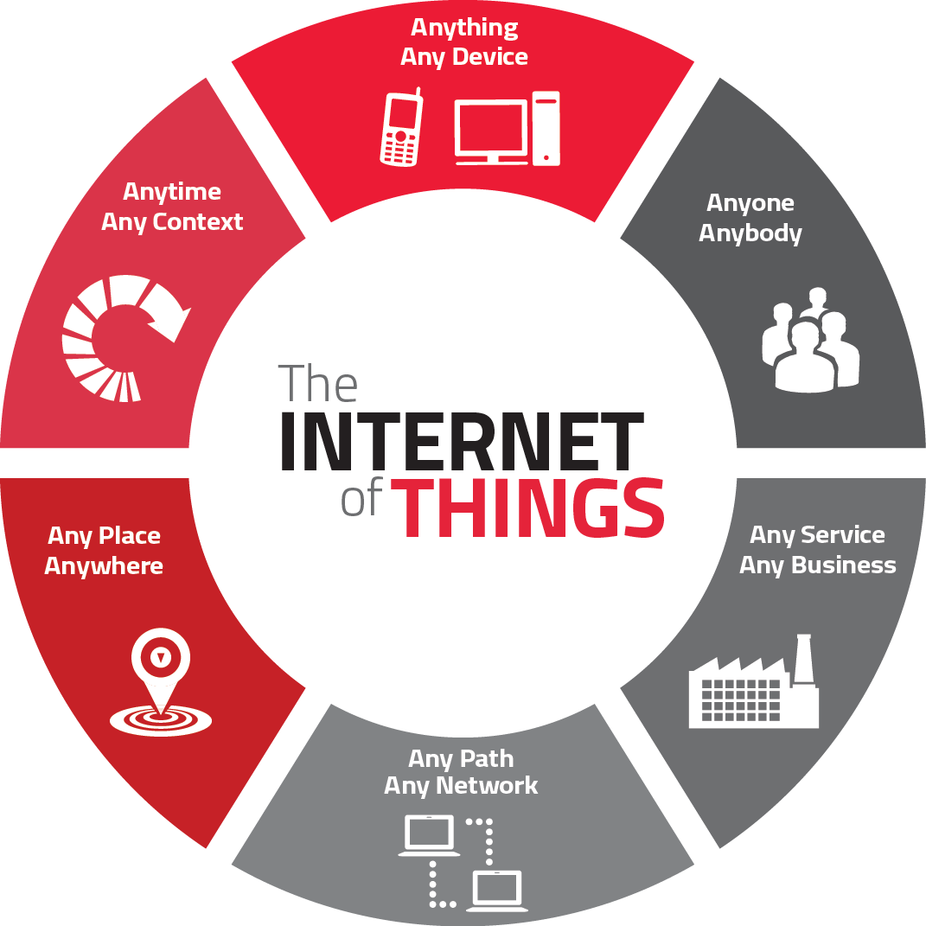
Internet of Things (IoT) Explained
Definition
The network of interconnected devices that collect and exchange data over the internet
Key Components
Devices
Connectivity
Data Processing
Could Infrastructure

Slide 3
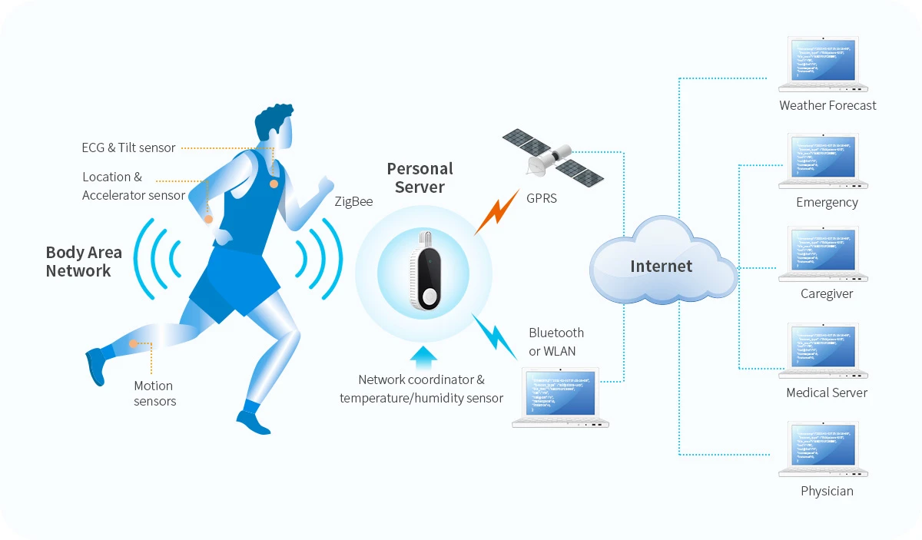
Applications of IoT
Smart Homes
Thermostats, lighting systems, anything controlled remotely
Industrial Monitoring
Ability to monitor and track equipment and machinery
Healthcare Applications
Wearable devices collecting healthcare data constantly
Smart Cities
Better traffic systems, waste management
Agriculture

Slide 4
Hardware

Slide 5
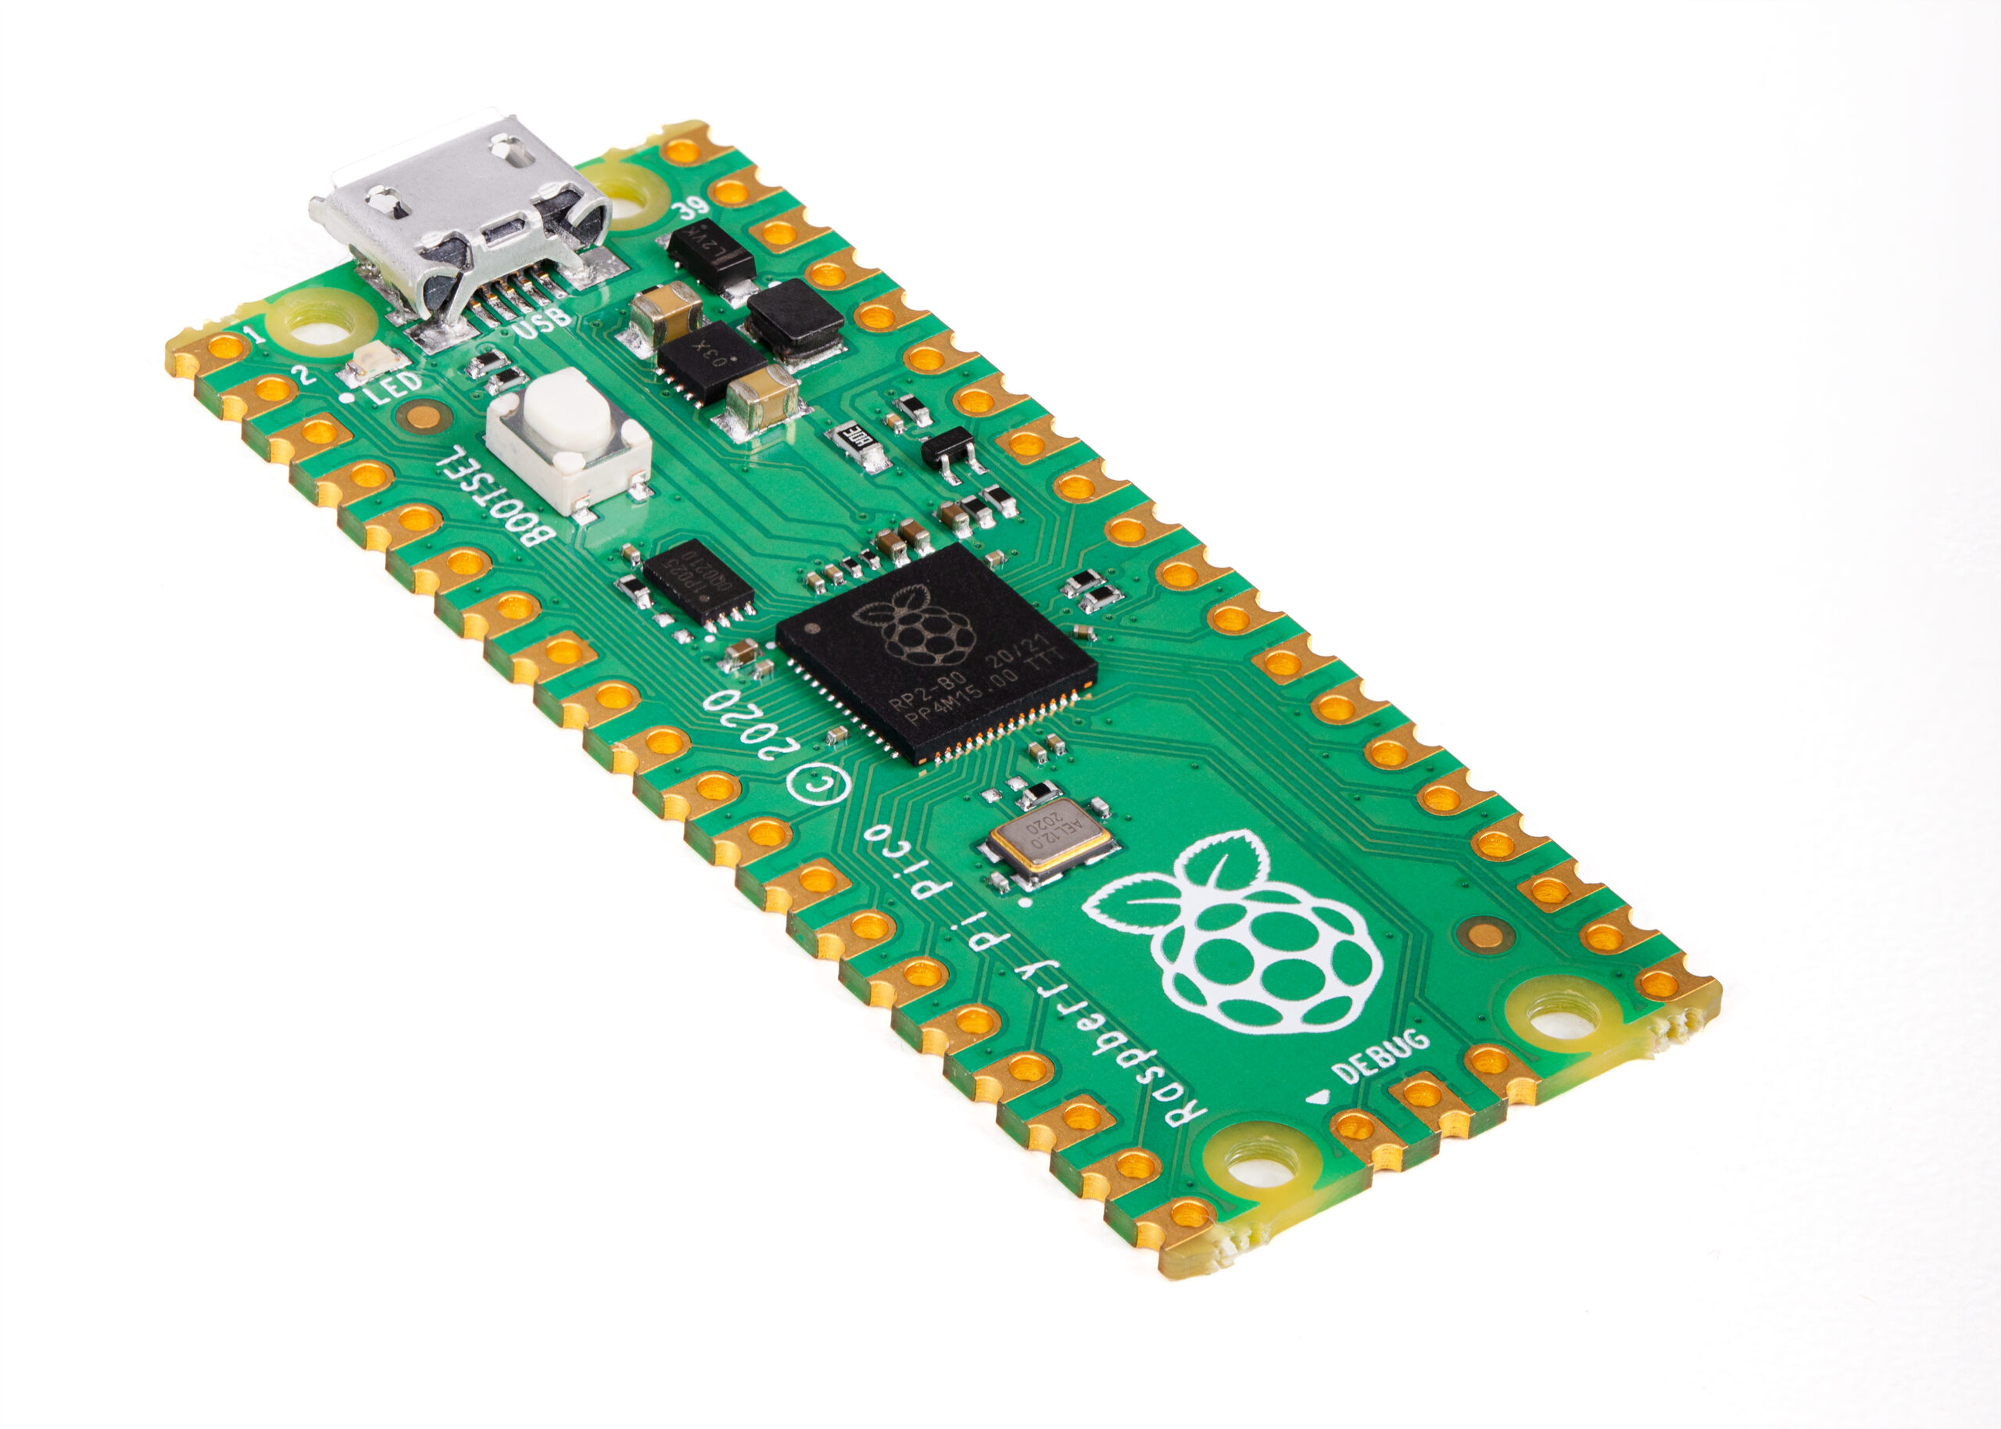
Raspberry Pi Pico
Developed by the Raspberry Pi Foundation
Cost effective
RP2040 Microcontroller Chip
Dual-Core ARM Cortext-M0+ @133 MHz
26 GPIO
2 MB onboard flash memory

Slide 6
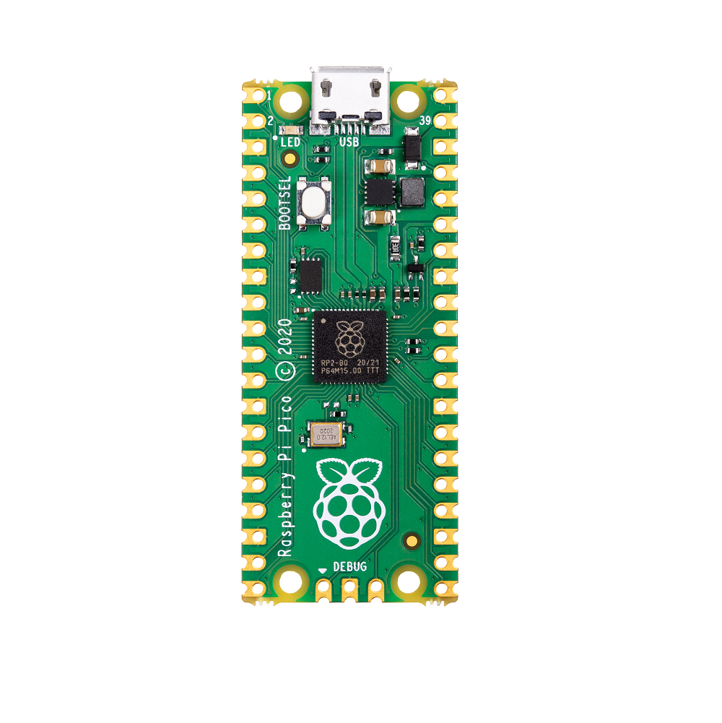
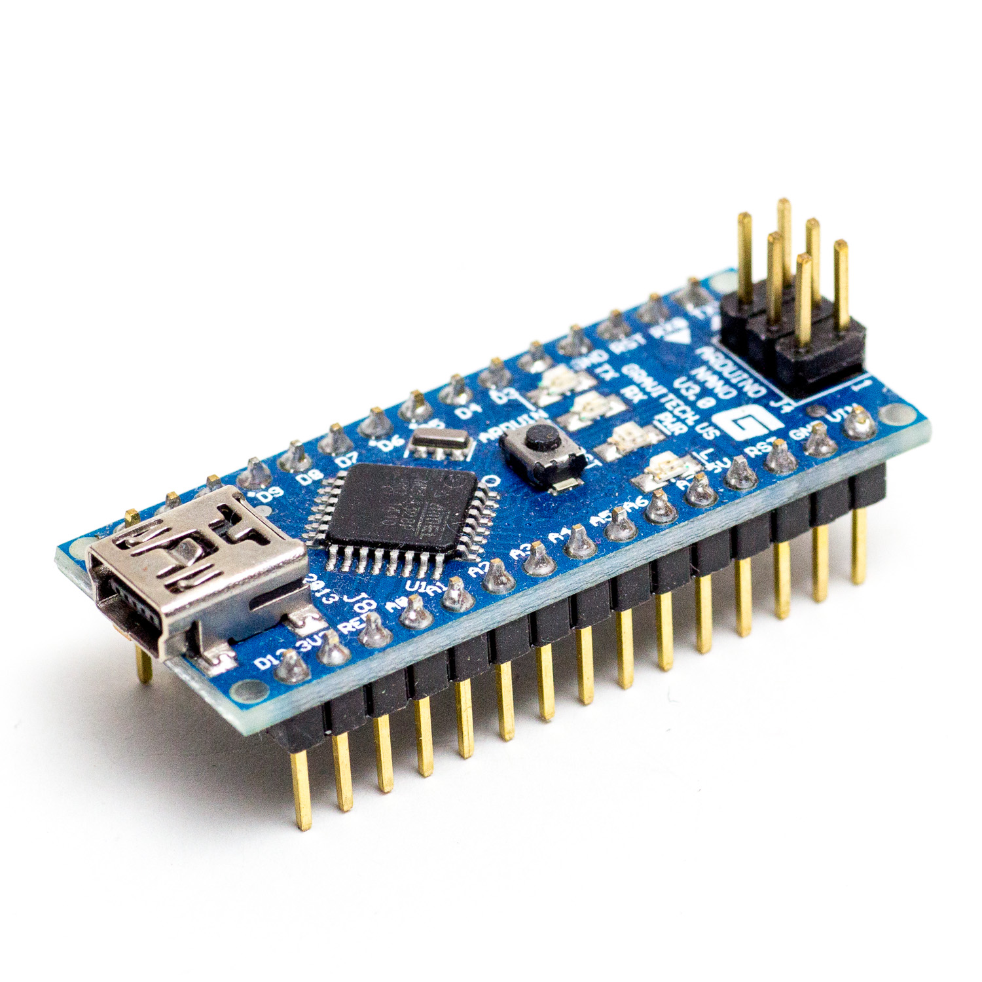
Pico Vs. Arduino
Arduino Nano
RP2040 Pico
Clock Speed: 16 MHz
Flash Memory: 32 KB
GPIO Pins: 22
Cost: $10- $15
Clock Speed: 133 MHz
Flash Memory: 2 MB
GPIO Pins: 26
Cost: $4 - $5
Notes:
Discuss why we chose to use the Pico for this lab. Make sure to express board choice is usually a preference and dictated by the restrictions and needs of the project.

Slide 7
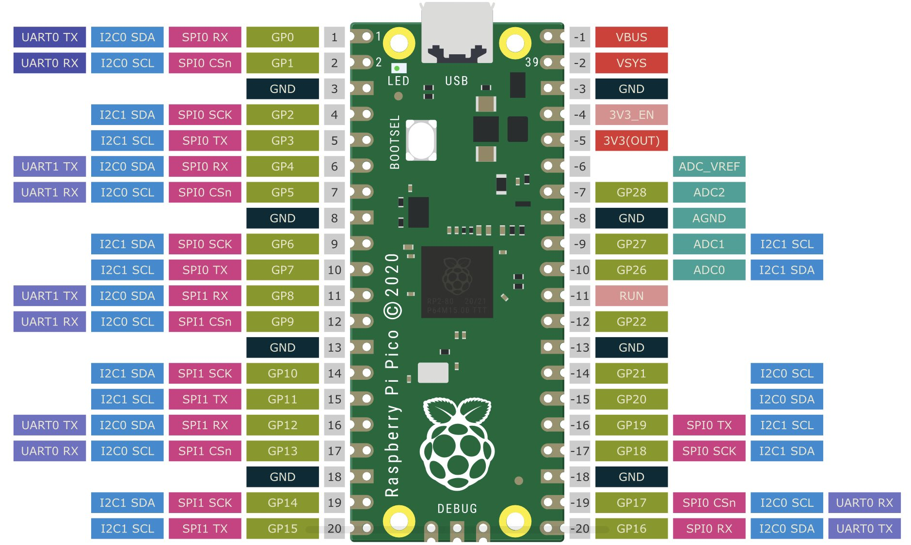
Understanding GPIO
UART (TX / RX)
I2C (SDA / SCL)
SPI (SCK, TX, RX ,Csn)
GP0-GP15

Slide 8
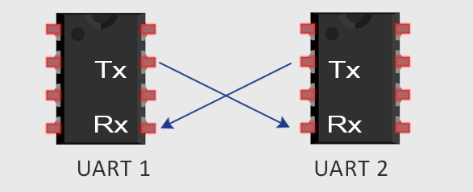
UART (Universal Asynchronous Receiver/Transmitter)
UART
A serial communication protocol used for point to point communication.
Uses two lines: TX (Transmit) and RX (Receive)
Asynchronous (no clock signal shared)
Very simple but effective means of communication

Slide 9
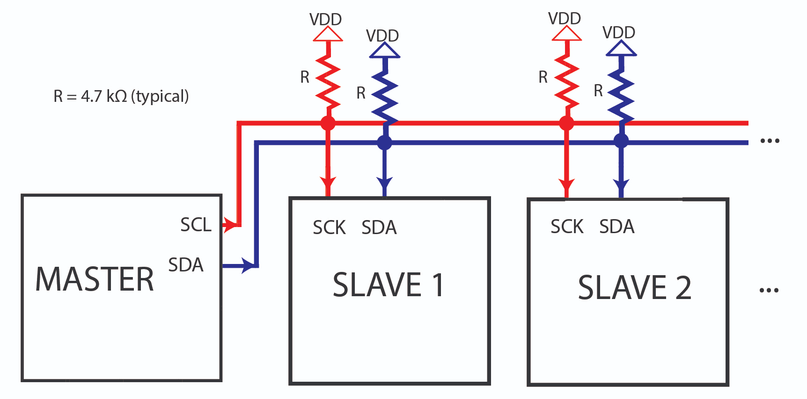
I2C (Inter-Integrated Circuit)
I2C
A serial communication protocol for connecting multiple peripherals.
Uses two lines: SDA (Serial Data Line) and SCL (Serial Clock Line)
Supports multiple devices on the same bus.
Communication initiated by master device.

Slide 10
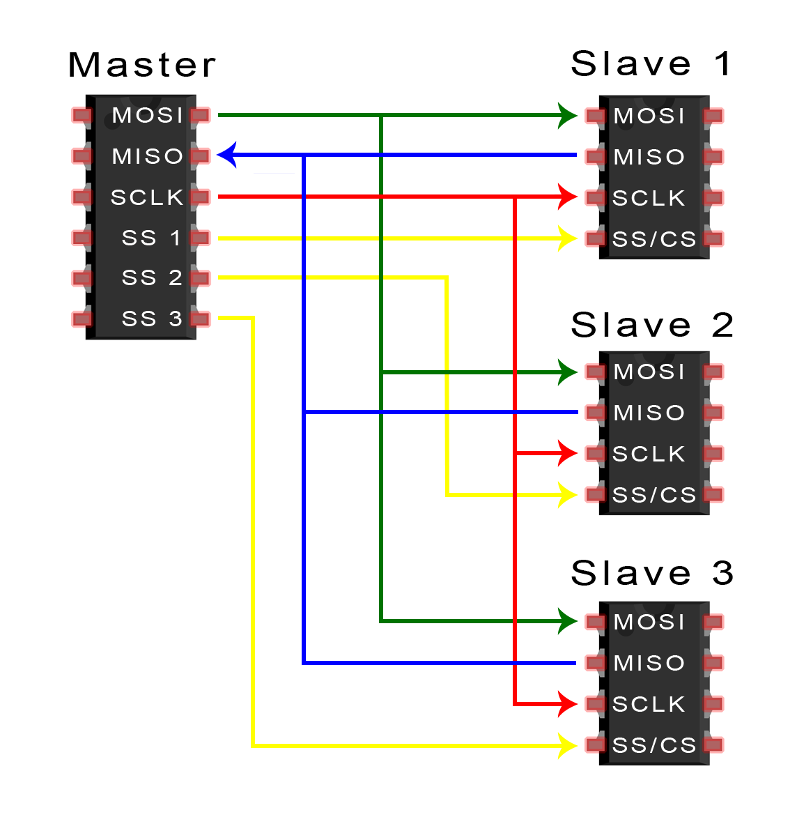
SPI (Serial Peripheral Interface)
SPI
A serial communication protocol for higher speed communication.
Uses four lines:
SCK (Serial Clock)
MOSI (Master Out Slave In)
MISO (Master In Slave Out)
CSn (Chip Select)
Supports multiple devices on the same bus.
Synchronous as it has a clock

Slide 11
Pico Pinout

Slide 12
Software

Slide 13
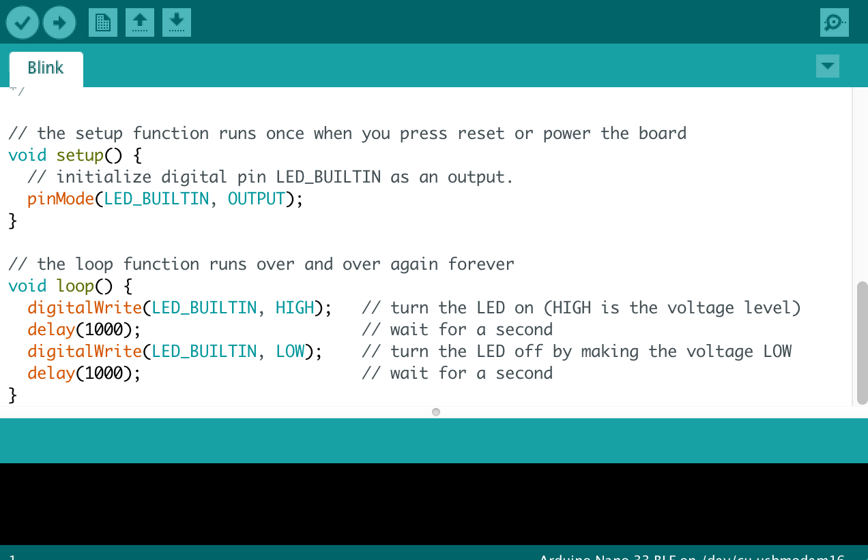
Arduino Software
C/C++ based software program for microcontrollers.
Pros:
Beginner Friendly
Widely supported
Cons:
Optimization issues
Restrictive program format

Slide 14
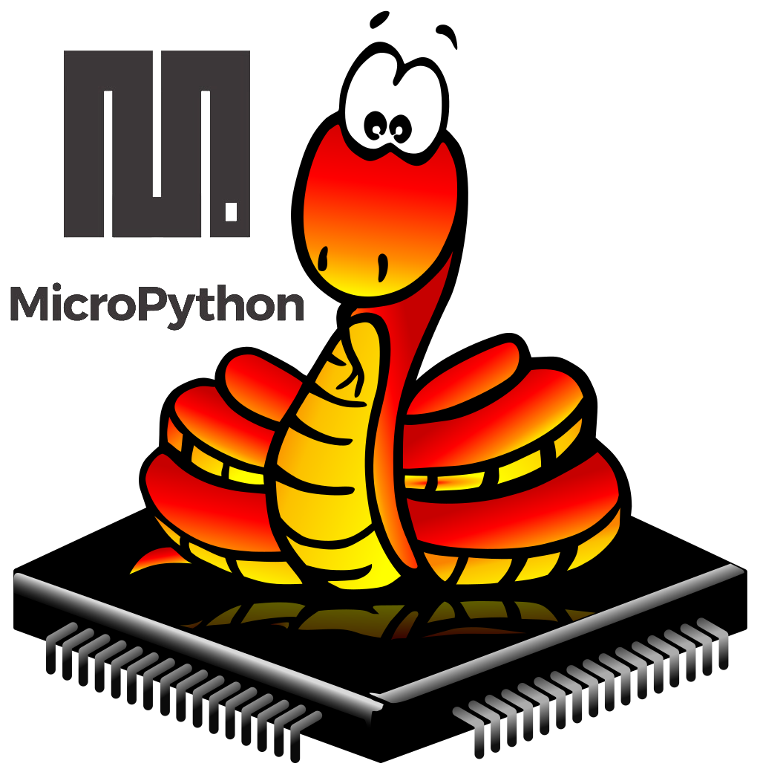
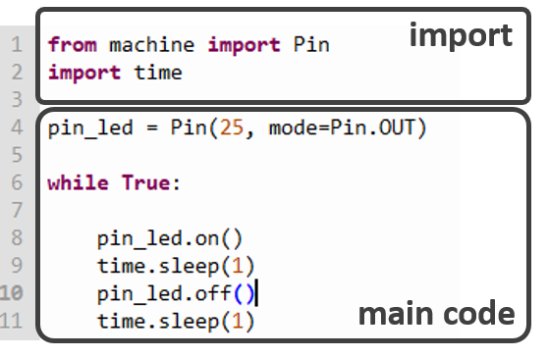
The MicroPython Platform
What is it?
A software implementation of Python 3 Programming language for microcontrollers.
Why Use it?
Lightweight
Python Compatibility
Lots of Libraries and Support
Cross Platform Support
Resources
Official MicroPython website: micropython.org

Slide 15

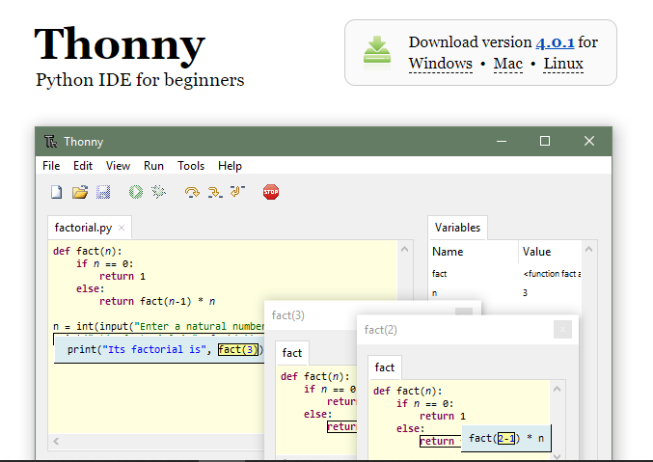
Our IDE of Choice: Thonny
What is Thonny?
An IDE (Integrated Development Environment) designed for Python and Micropython Development
Why Thonny?
Beginner Friendly
Lightweight and Fast
Lots of Support

Slide 16
Install Thonny
https://thonny.org/

Slide 17
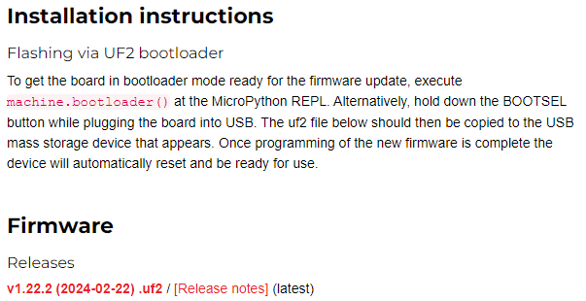
Pico Firmware
Microcontroller Firmware
Multiple supported languages:
MicroPython
CircuitPython
C/C++
Rust?
This means we need to flash the firmware for our preferred language

Slide 18
Flashing the Pico
https://github.com/hess105/IoT-Workshop/tree/main/MicroPython-Framework

Slide 19
Micropython Basics
https://github.com/hess105/IoT-Workshop/tree/main/MicroPython-Framework/The-Basics

Slide 20
LED Program

Slide 21
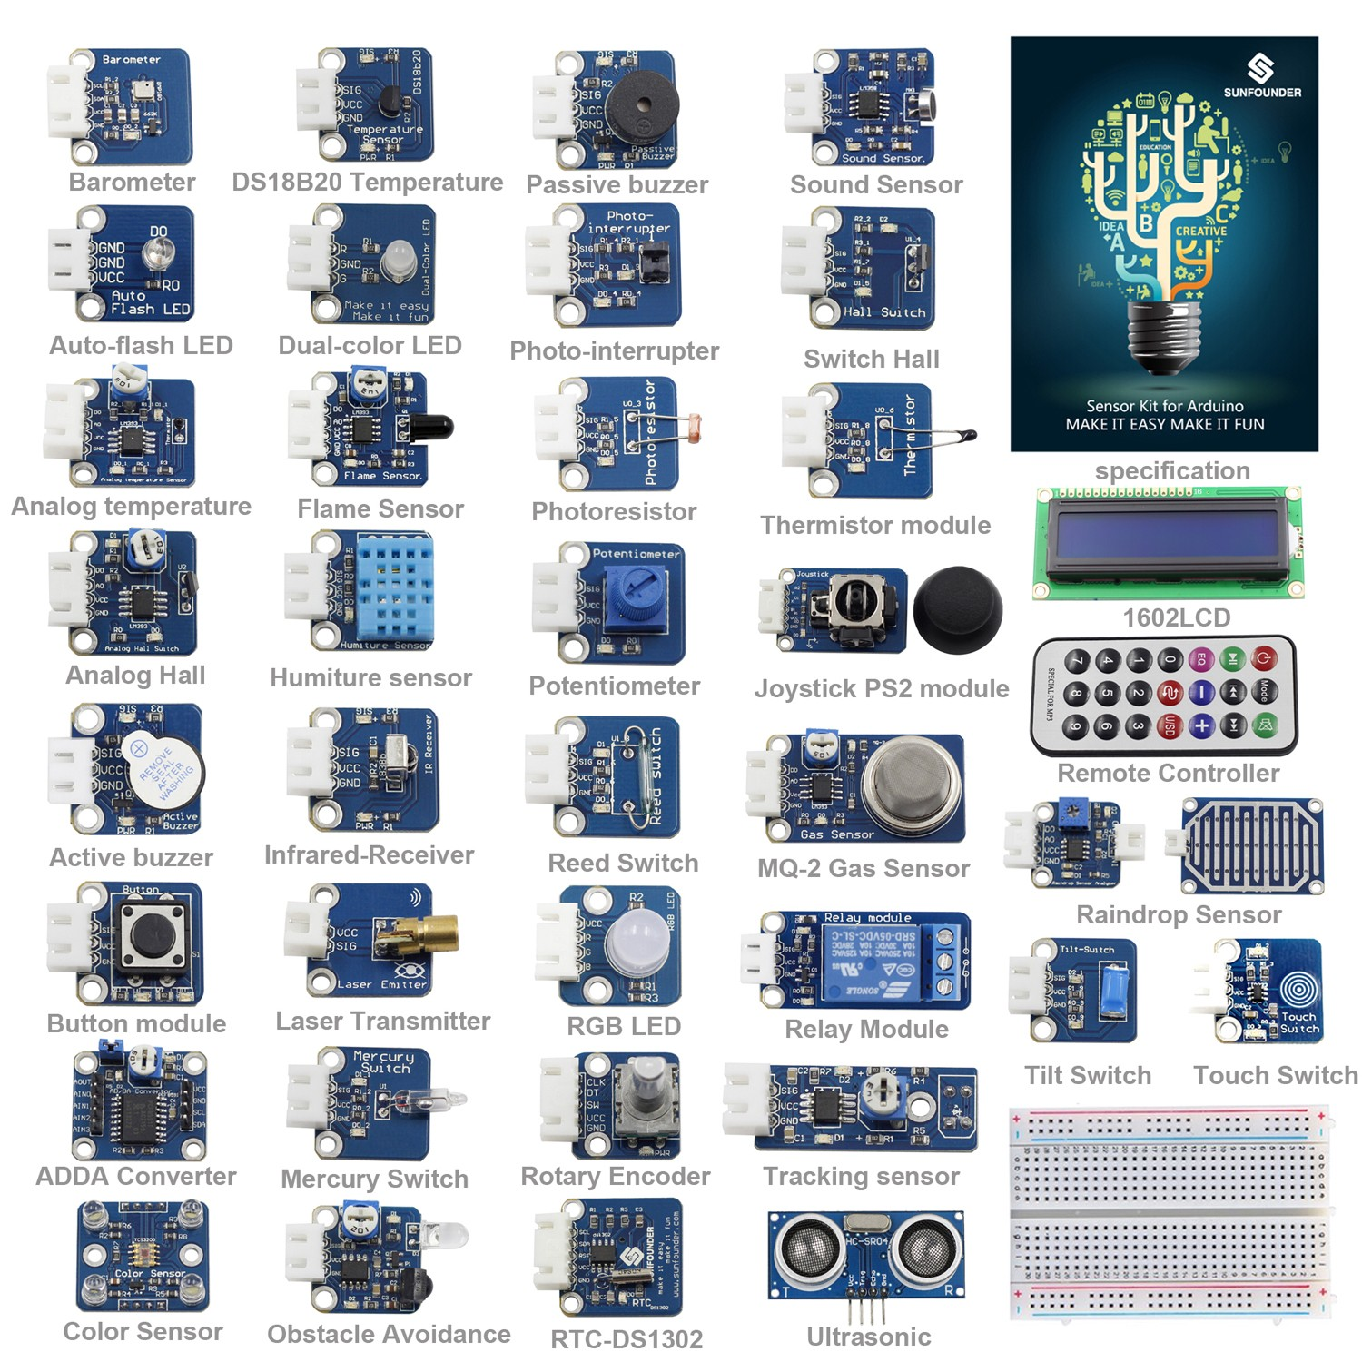
Basics of Sensors

Slide 22
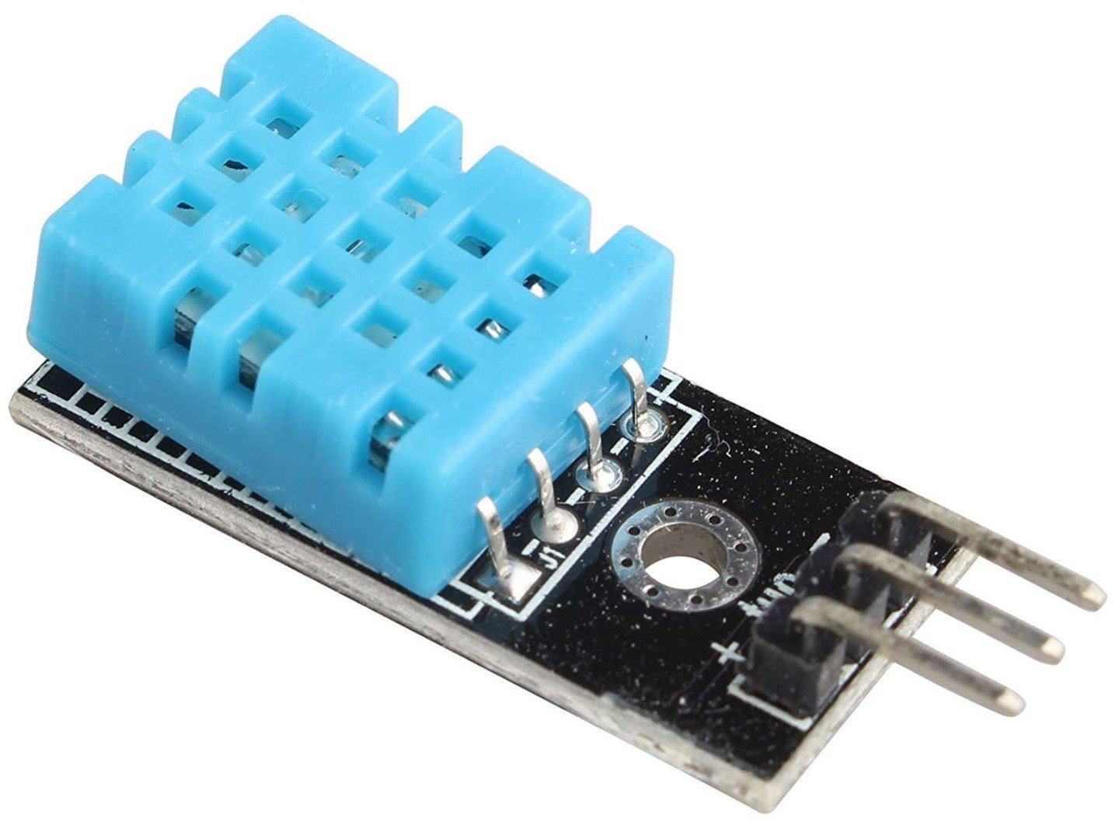
DHT11
Low cost digital temperature and humidity module
0 – 50 C (+/- 2 C)
20 – 90% Humidity (+/- 5%)
Contains a thermistor for temperature and capacitive humidity sensor.
3 Pins
VCC
DATA
GND
So what communication protocol does it use?
What Pins would we connect it to?

Slide 23
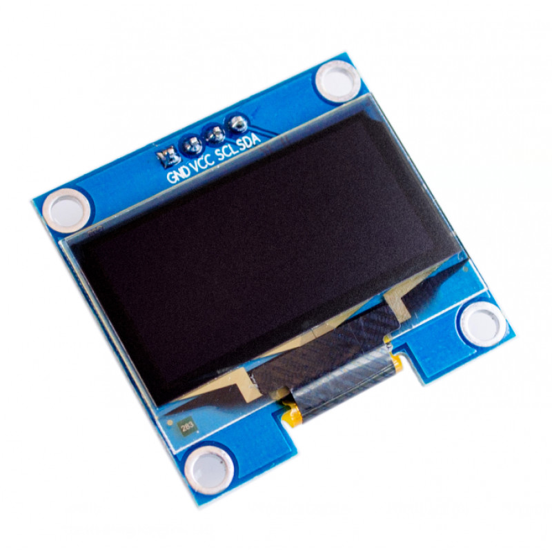
128 x 64 OLED Screen
Monochrome and Low Power Display
4 Pins
VCC
GND
SCL
SDA
So what communication protocol does it use?
What Pins would we connect it to?

Slide 24

Importing Libraries
For additional functionality we will use libraries.
Built-In Libraries can be included with only the import command
Third-Party Libraries need to be physically added to the IDE in Thonny.
Keep in mind the limited memory available on microcontrollers when importing libraries. Avoid unnecessary imports to conserve memory.

Slide 25
Reading Sensor Data
https://github.com/hess105/IoT-Workshop/tree/main/Project-2

Slide 26
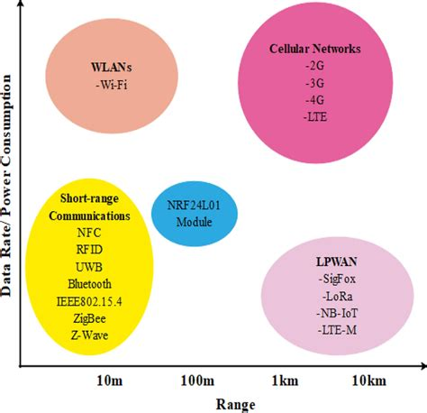
Wireless Communication
Transmission of data between devices without physical wires
Key Technologies
Wifi (IEEE 802.11)
Bluetooth (Short Range)
LoRA (Long Range)
Cellular (3G, 4G, 5G)

Slide 27
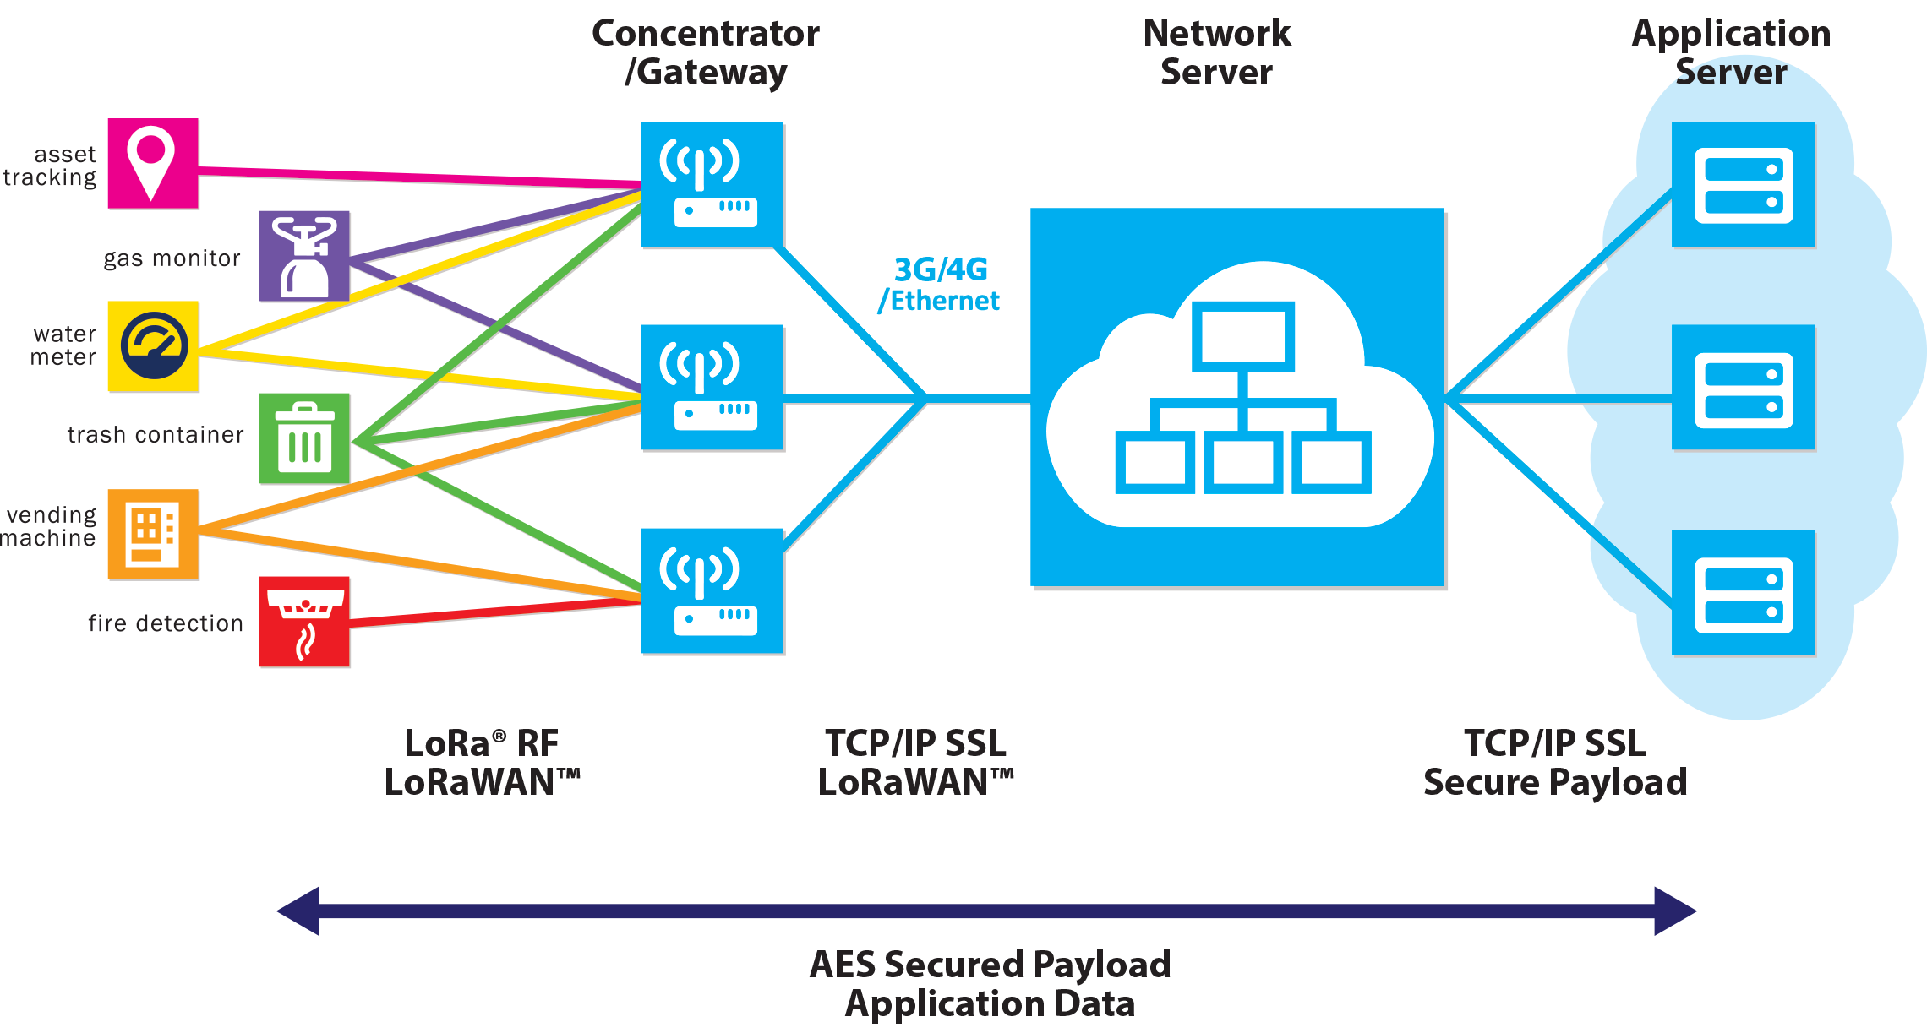
LoRa and LoRaWAN
LoRa
Proprietary wireless modulation technology developed by Semtech.
Long-range communication with low-power consumption (several Kilometers line of sight)
LoRaWAN
Protocol built upon LoRa physical layer that defines the communication protocol and network architecture.
Enables secure bi-directional communication with router like devices.

Slide 28
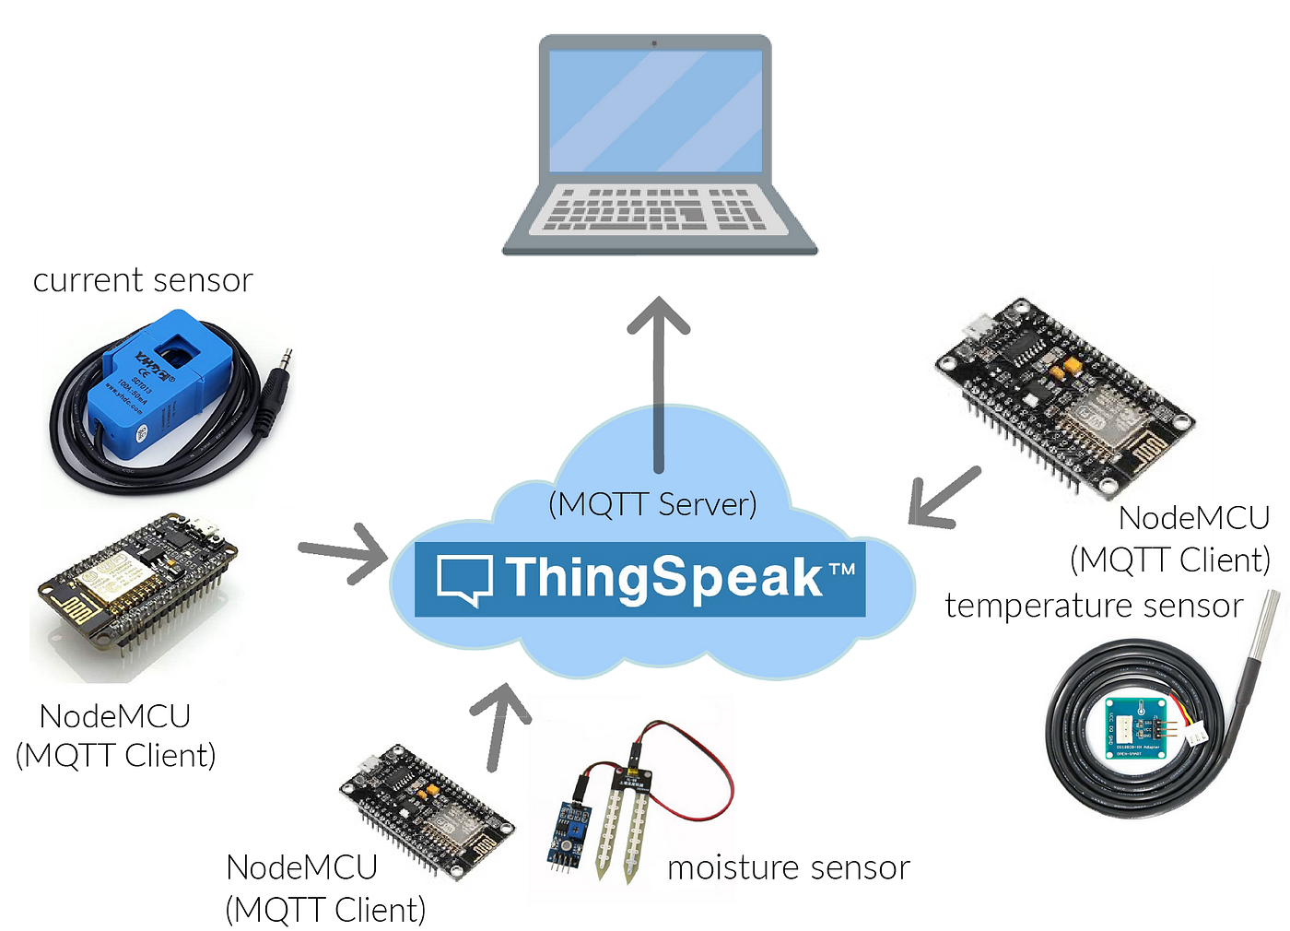
ThingSpeak
Open-Source IoT Platform
Developed by MathWorks (same people as MATLAB)
Key Features
API and libraries for collecting data from IoT devices
Provides a spot for data storage
Data visualization and analysis tools
Uses
Environmental Monitoring, Home Automation, Smart Agriculture

Slide 29
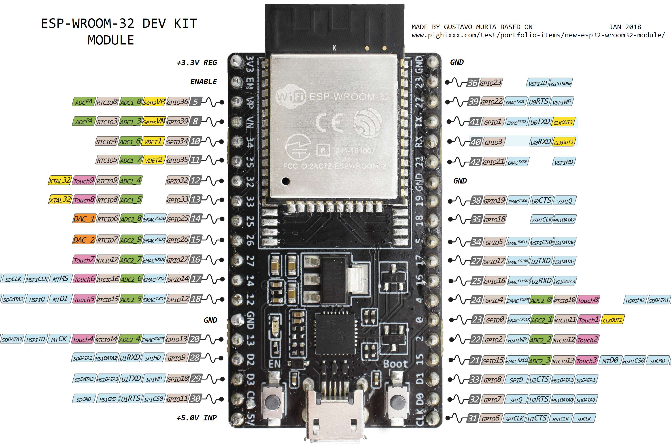
ESP32
Dual-Core Processor: ESP32 features two Tensilica LX6 CPU cores, offering high performance and efficiency.
Variable Clock Speed (80 – 240 MHz)
Wi-Fi: Built-in Wi-Fi support, including 802.11b/g/n Wi-Fi standards
Bluetooth: Integrated Bluetooth 4.2 and Bluetooth Low Energy (BLE)
Low Power Consumption

Slide 30
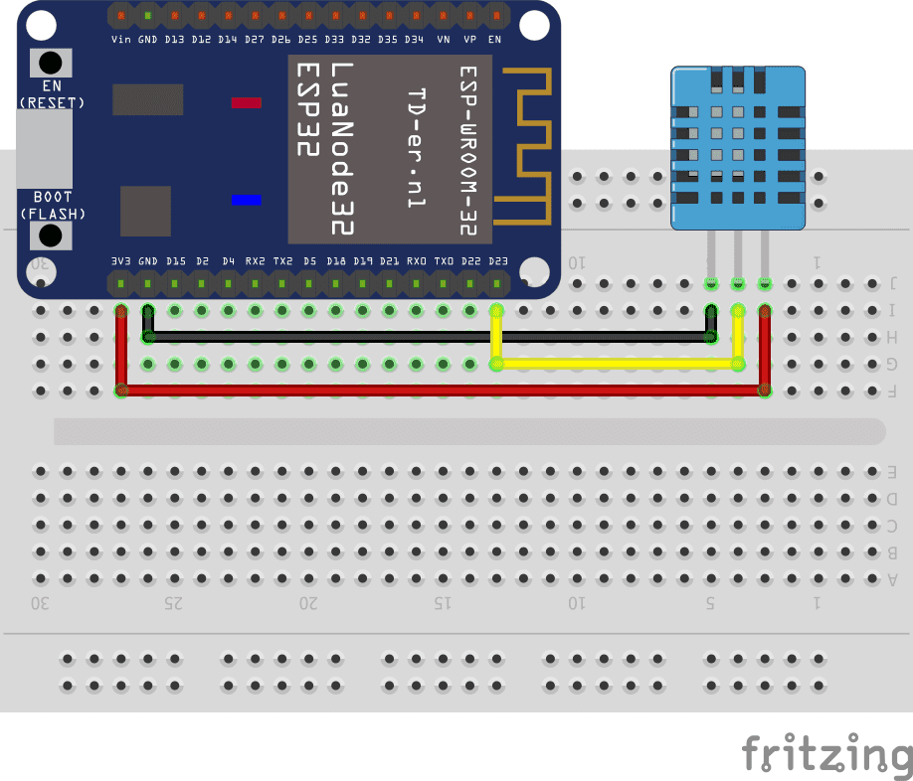
ThingSpeak Integration w/ ESP32
https://github.com/hess105/IoT-Workshop/tree/main/Project-3

